Slide 1
Beyond endpoint security using osquery at scale
TECH-W16
Prateek Kumar Nischal
Prasoon Dwivedi
Senior Software Engineer
WM Global Tech India
@pikaynu
Staff Software Engineer
WM Global Tech India
@mitprasoon

Slide 2

Why endpoint security is important?
Notes:
IMAGE SOURCE: https://pixabay.com/photos/cyber-security-online-computer-2296269/
This will be the slide which will set the context. We shall be tall in brief about the endpoint devices (servers, laptops, associate PCs, tablets and other devices) and why it is important for an enterprise to safeguard them.
Opening story:
Any organization has a bunch of endpoints distributed throughout their network. This means there are so many entry points to the network.
Endpoint vulnerabilities holds keys to an enterprise network.
It’s a bit scary to not have visibility on the resources and what’s running on them. For a particular endpoint, there are multiple systems that manage and track events on an endpoint. To track a malicious event on the network, multiple data sources need to be investigated, collated and correlated. These sources and systems lie across function boundaries, roles and types. This would require significant post processing delaying an information discovery.
To kick off a triaging, one would need to location of the resource, owner, symptoms (indirect effects of an event) on the network and resources. This could be dealt with a system that can collect information about a resources and enrich it with context at the origin itself.
Usually, there are scanners and agents that keep polling the network/ resources to get the state and then post process it to make out any information from it. Instead of polling, we could use an agent that triggers only if the state changes and all of it is done on the resource itself reducing complexity and cost of post processing infrastructure. All of this is Red teaming. For the team blue, security teams need to make sure the infra is in continuous compliance. Make sure user activity is accounted for, latest patches, integrity of sensitive files etc. For this, again data needs to be filtered and collected to create a crisp report to highlight the state of resources and any unauthorized activity. It’s more of proving that the resources were under observation. For that we need a secure and immutable event pipeline.

Slide 3

Challenges with Endpoints in an Enterprise setup
Visibility on heterogeneous resources
Keeping up with the trend
Overcomplicating endpoint security
Accountability and ownership
Overprioritizing antimalware
Regulatory, compliance and Policy Enforcement
Notes:
IMPORTANT NOTE: This slide has animation, please view it in slideshow mode.
IMAGE SOURCE: https://pixabay.com/vectors/puzzle-pieces-jigsaw-piece-concept-308908/
This slides captures the most common issues and challenges with endpoint agents in an enterprise setup. We shall talk about a few of these challenges in brief.
Challenges
Visibility on resources -
Heterogeneous Resources
Keeping up with the trend
Overcomplicating endpoint security – too many options to choose from leading to higher resource consumption
Accountability and ownership
Overprioritizing antimalware – It’s not just malware that we need to lookout. There are other information sources that needs to be looked at outside of the threat window.
Regulatory and compliance
Policy Enforcement

Slide 4
Introduction to Endpoint Security
Collecting the right events is just half the solution

Slide 5

Endpoint Security: Requirements
Endpoint agents
Immutable event pipeline
Alerting and triaging setup
Easy and reliable extraction of information for compliance audits
Events should be actionable and open to stakeholders
Notes:
IMPORTANT NOTE: This slide has animation, please view it in slideshow mode.
Image Source: https://pixabay.com/photos/network-server-system-2402637/
Implementing endpoint security doesn’t just require installing agents that collect data about a resource. It involves setting up a complete pipeline of immutable events which allow active detection, alerting and triaging.
It should allow auditors to look at the data and extract reliable data from it to use as evidence for compliance.
The data sitting in a warehouse isn’t exciting. It needs to be available to everyone to analyze and take action upon.

Slide 6

Compliance Requirements
Detect vulnerable infrastructure
Audit trail for every resource all the time
Proof of integrity or detect compromised audit pipeline
Visibility into the state of audit for a network
Notes:
IMAGE SOURCE: https://pixabay.com/vectors/risk-assessment-paperwork-compliance-510759/
What do you need from a compliance perspective ?
Ability to preemptively detect vulnerable infrastructure. Keep a track of what packages are running and if any of them are vulnerable.
Keep track of events / activities that may help in constructing an audit trail during triaging
In order to carry out patching and triaging, you need to find the owner of a particular resource. A person responsible for it. Have visibility of what is deployed and who owns it.
Proof of integrity for the audit pipeline, make sure it’s tamper resistant. And, in an event of a compromise, ability to detect if the audit pipeline has been tampered with
It’s important to know what audit components were deployed at a particular point in time to be able to pull up historic data. Audit config should be versioned with all versions tracked.

Slide 7
Infrastructure Setup for Endpoint Security
Deploy event collectors (agents) everywhere
Normalize events from all agents
Setup trusted transport for events
Setup command and control server for config distribution
Notes:
The bootstrap problem – once you have the solution, how do you get it deployed and running with the least complexity possible
To build a pipeline, one needs a few broad steps
Deploy event collectors on all the resources that needs auditing
Most agents generate events in a different format and for being useful it needs to be normalized and annotated
Setup a reliable and trusted transport for the events that is efficient as well
Setup a command and control server that controls the agent behaviour

Slide 8

The Wishlist
No custom or complex deployments
Guaranteed configuration integrity
Ownership and identity tagging for faster triaging
Unified control across the agents
Native and resilient logging solution across the organization
Notes:
IMAGE SOURCE: https://pixabay.com/photos/checklist-check-rectangles-list-2470549/
We need to minimize the number of complex deployments, not spend most of our time in trying to adapt one component for other
Configuration, one of the most important aspects in the event pipeline needs to have strong guarantees for it’s integrity
Given the diverse formats of events and information and log collection methods, how do you extract the information that makes sense to you
Not all collectors annotate the data with enough information to allow identity and ownership detection
There must be a single mechanism to control and configure the agents instead of using different methods and routes
Application team won’t be happy if you keep adding agents alongside their application. And managing a totally separate event log pipeline needs expertise. Using the org-native logging solution makes the most sense.

Slide 9

The Audit Framework
An attempt to achieve a trusted event pipeline to serve as evidence in compliance

Slide 10
osquery – For endpoint security
osquery by facebook
osquery is an opensource endpoint visibility tool that exposes OS events and information via a SQL interface.
Notes:
IMPORTANT NOTE: This slide has animation, please view it in slideshow mode.
Osquery is a tool built to expose the OS state with a SQL engine that gives strong correlation and filtering capabilities in the organization largest and most distributed compute resource.

Slide 11
osquery – For endpoint security
osquery by facebook
Why osquery?
Implements TLS config plugin and TLS logger plugin
Can get configuration from remote host
Can send logs to remote endpoint
Extremely flexible
Notes:
Osquery is a tool built to expose the OS state with a SQL engine that gives strong correlation and filtering capabilities in the organization largest and most distributed compute resource. (most of the text in the slide is what the speaker intends to speak)s
osquery implements the TLS config plugin and TLS logger plugin, it’s native config and logging plugin can fetch from and send logs to a remote endpoint which implements the TLS plugin spec.
It’s extremely flexible with its plugin framework. The audit framework extends on what osquery already offers using the plugin framework.

Slide 12
The Audit Framework
What it does?
The Endpoint agent(s) behavior
Configuration build and distribution
Integration with the Linux audit framework
Notes:
IMPORTANT NOTE: This slide has animation, please view it in slideshow mode.
IMAGE SOURCE: https://pixabay.com/illustrations/exam-scientific-experiment-2428208/
The Audit framework is set of guidelines that defines how each component must behave in order to setup a pipeline for. It adds guarantees for protecting configuration, makes bootstrapping easy and helps extract evidence to prove continuous compliance.
In an attempt to solve the problems, we came up with an audit framework that attempts to standardize the way agents behave, events are handled and transported, configuration is distributed and how to use all of this to extract the most relevant t information and then act on it. In one of the implementations, we use the linux audit framework with osquery to fulfill the requirements.

Slide 13

Ensure Integrity & Compliance
Monitor
Version of the agent(s) deployed
Integrity of the agent(s)
Any permission changes to the agent(s)
Uptime / heartbeat for the agent(s)
Any config generated at runtime
Notes:
IMAGE SOURCE: https://pixabay.com/vectors/search-loupe-document-97587/
To have confidence or detect any compromise, some crucial things to monitor are
The agents haven’t been tampered with and are running the expected version
Any changes in the permissions as it could hamper its visibility into the OS
Make sure the agent is running and detect when it was restarted as there could be a dark time between restarts
Monitor and report any configuration that is outside of the config distributed, i.e. generated at runtime based on runtime parameters.

Slide 14
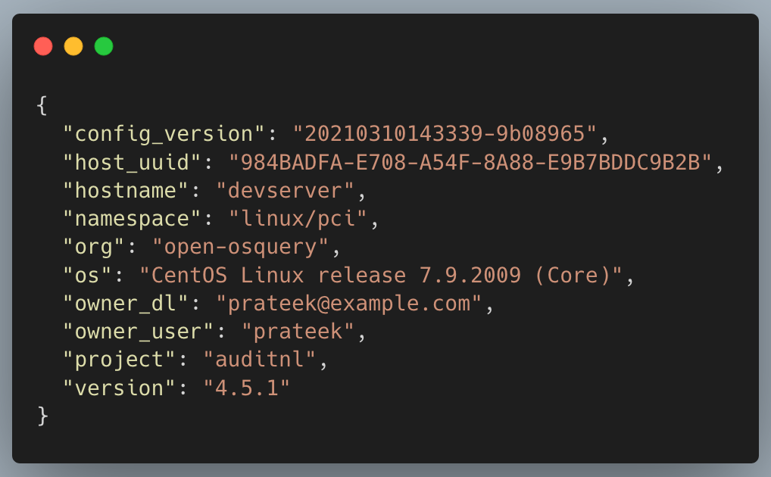
Event tagging for triage and accountability
Host Identifier, IP
Configuration version
Organization Segment
Owner Group
Owner
Notes:
IMPORTANT NOTE: This slide has animation, please view it in slideshow mode.
IMAGE SOURCE : https://pixabay.com/illustrations/community-connection-woman-select-4536852/
Annotate the event logs with relevant information so that each event has sufficient data in order to track where it came from and who does it belong to. This also make it easier in terms of integration as all of this information is available during provision of a resource.
owner, an individual responsible for the resource
owner group, a group of people responsible for the resource
organization segment, an identifier for organizational segmentation, i.e., pillar, team, location, etc
host identifier, unique identifier to locate a host, could include IPs and dynamic names
All the above information can be established by the orchestrator during installation or configuration, again making it accounted for and self service.

Slide 15
Configuration build and distribution
Perhaps one of the most important component in the pipeline

Slide 16


Configuration Management
Implement osquery’s built-in TLS config plugin
Extend the plugin to handle varied configurations not just osquery’s
Simplify bootstrap process by serving the config from a simple file server which can also extend to a full-fat API server
Notes:
A popular way to configure osquery is the TLS config plugin which needs a centralized server and limited to distribute osquery config. This can be modified to a universal config management tool where an config plugin can get config for all agents under the audit framework. Additionally, the config source could be a very simple file server to simplify bootstrap and integration of the solution.

Slide 17
Configuration Management Continued…
How to ensure CIA?
Digitally sign configuration made available through HA setup
Trust based on PKI and x509 certs
Custom certificate attributes
Versioned configuration
Metadata embedded with configuration under security envelope
17
Notes:
IMPORTANT NOTE: This slide has animation, please view it in slideshow mode.
IMAGE SOURCE: https://pixabay.com/vectors/shield-security-protection-sure-1086703/
The config is open but enclosed in a digitally signed envelope that uses regular PKI for trust. It’s much like how JWE works, the claims are public but immutable.
The security safeguards on the configuration build and distribution
Digitally signed configuration open to everyone
Trust based on X.509 certificates and organization CA as the trust anchor
Custom attributes for exclusive certificate issue access by the CA
Versioned configuration with metadata embedded in the configuration under the signature envelope
CIA - Confidentiality Integrity Availability

Slide 18
Benefits of an explicitly secure configuration
Insecure fileserver can be used out of the box
HTTP GET based fetch enables easy integration with orchestrators
Easy determination of state of running config through versioning
Trust relies on CA and not on shared secret
Self-serviced with minimal components
Notes:
Having explicit protection built in the config allows it to be transported from very simple fileservers which can have a caching proxy sitting on top of it making it highly performant. Due to that, all config fetch requests are GET only.

Slide 19
Integration with the Linux audit framework
Most trustworthy source of information - A beast that needs taming

Slide 20

Linux Audit Service
What can it do?
Process execution and malware detection
syscall auditing for sensitive files
File integrity monitoring for read and write operations
User activity
Network activity
Notes:
IMAGE SOURCE: https://pixabay.com/vectors/tux-animal-bird-book-books-161406/
One of the most reliable and accurate sources of dynamic audit event information is the Linux Audit service. This can be used to collect
Process execution and malware detection
Syscall auditing for sensitive files
File integrity monitoring for read and write operations
User activity
Network activity

Slide 21
Challenges with the Linux Audit framework
Too static, configured using auditctl(8)
Does not support patterns and globs
Emitted logs require post processing
Notes:
It has some problems though. The linux audit config is very static and is usually configured using auditctl which is a bit clumsy for automating. It does not support patterns and globs, so it may end up tracking more what is necessary leanding to performance degradation. Also, the logs emitted by the audit service are like stream of logs which needs correlation and annotation in order to make it usable for processing. Tools like slackhq/go-audit and elasticsearch/auditbeat try to solve the problem but they are restrictive in terms of integration and filtering.

Slide 22
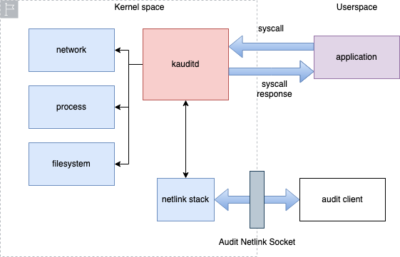
How does osquery handle audit events
Notes:
Osquery is another such tool that can read logs from auditd and parses it into a modern format. It does that by connecting to the netlink socket of the audit family over which the logs are written by the kernel. It then parses it and applies it’s SQL style filtering for more contextual data.
The audit events are messages from kernel to userspace over the netlink socket. osquery connects to this socket, reads and parses the events and exposes them via the auditeventpublisher.
osquery relies on userland filtering for events as it’s much more flexible due to the embedded SQL. But this does not leverage the event classification and filtering capabilities of the kernel.
The way osquery handles audit rules, it can lead to a lot of noise, making osquery to process a lot of uninteresting events and use more than necessary resources.

Slide 23
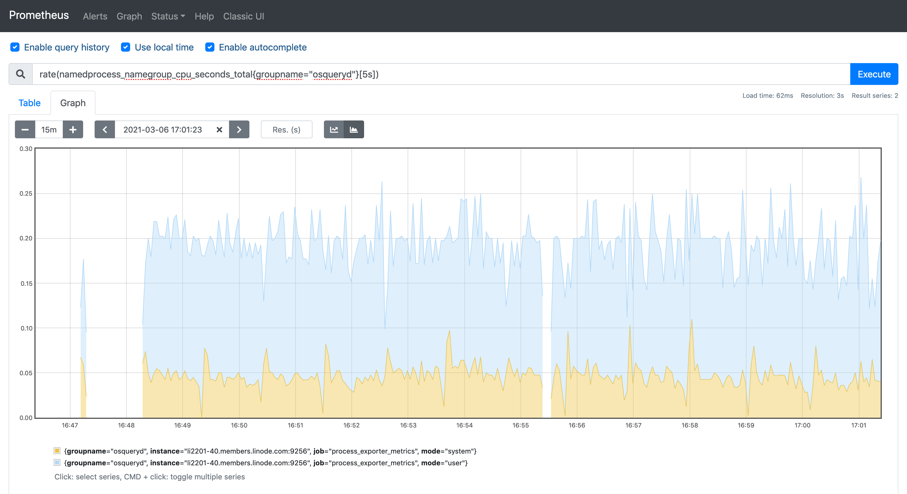
osquery performance with bulk event filtering
Notes:
For a busy system, that emits a log of (irrelevant) logs, osquery reads all of it, parses it and ends up discarding most of it leading to overusing or resources. This could event lead to osquery’s resource limiter kicking in and respawning itself.

Slide 24

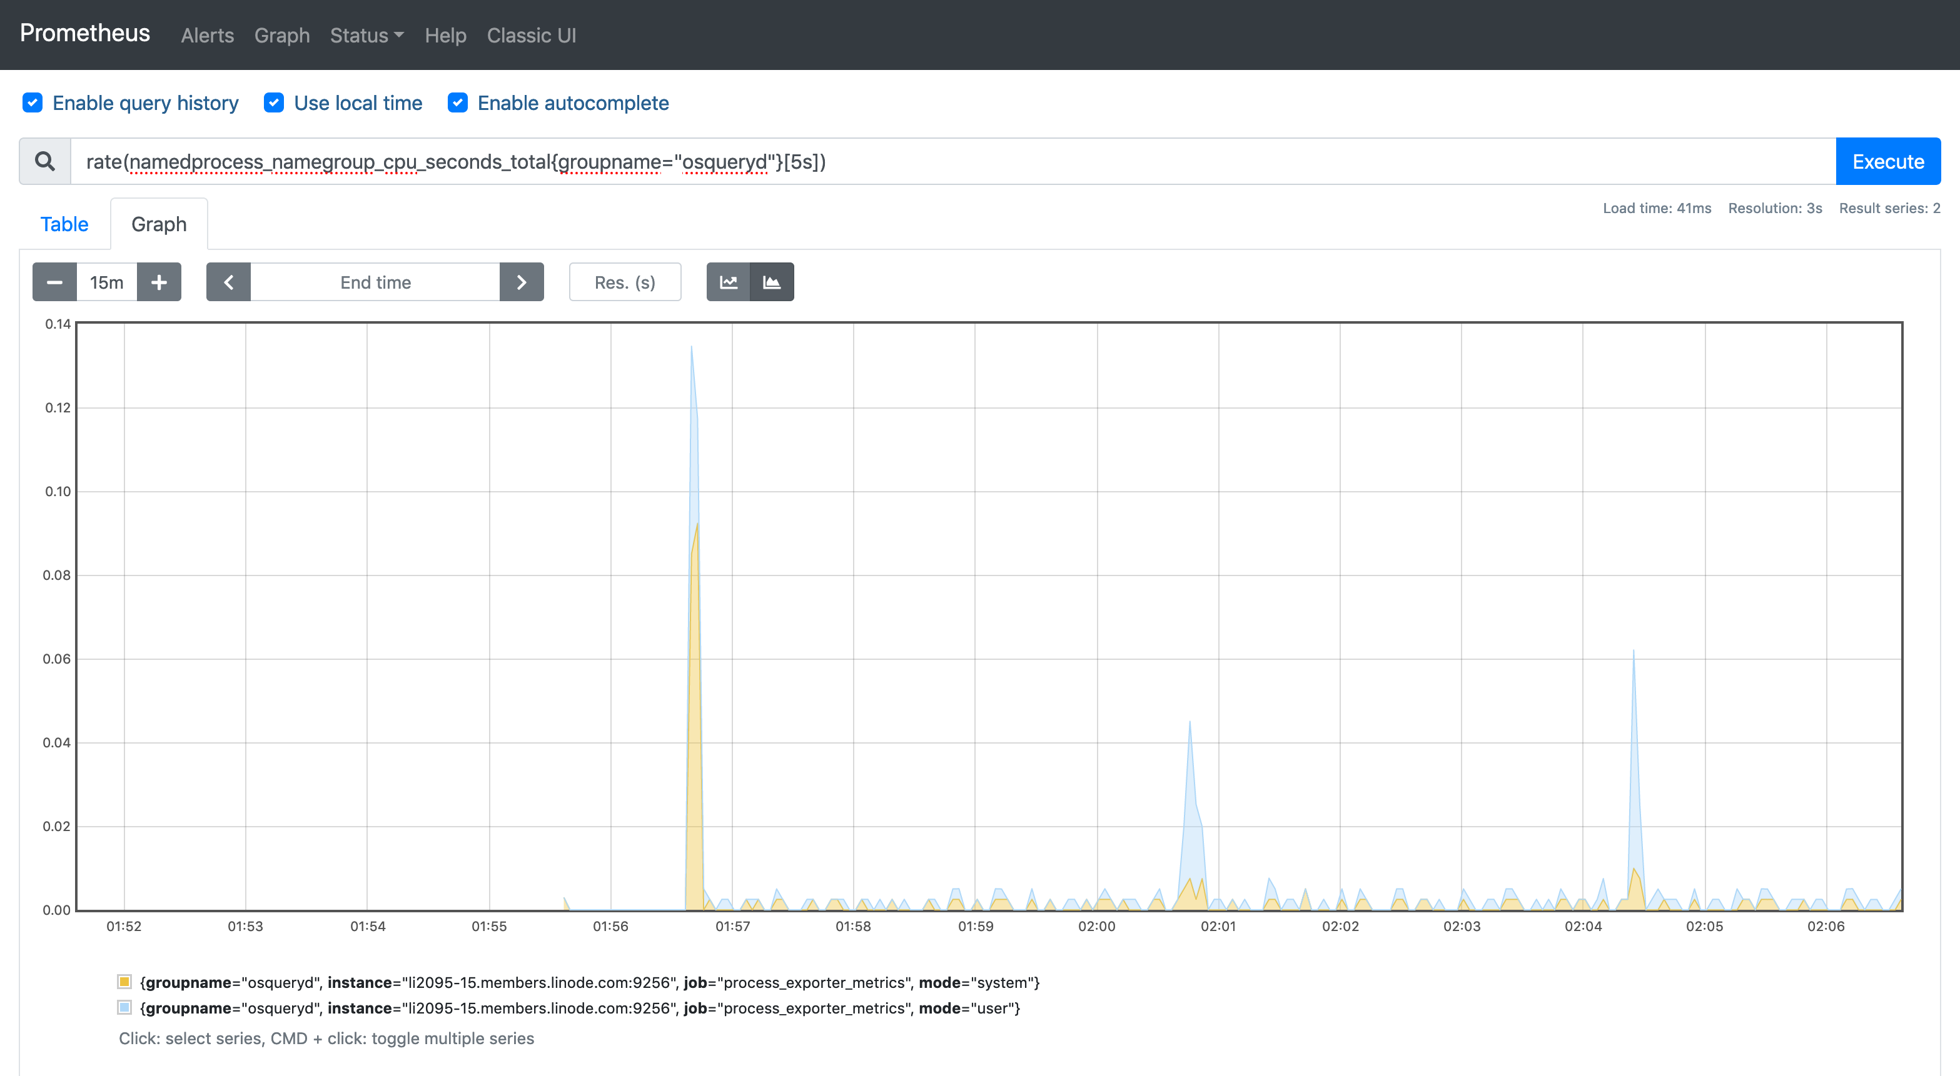
osquery performance assisted by Linux Audit
Notes:
For a busy system, that emits a log of (irrelevant) logs, osquery reads all of it, parses it and ends up discarding most of it leading to overusing or resources. This could event lead to osquery’s resource limiter kicking in and respawing itself.

Slide 25
Extension framework for osquery
Best of both worlds
The efficient kernel space filtering using tailored rules
osquery to trigger, manage, consume and filter data using it’s SQL engine
Annotate the data with the required metadata and publish.
Notes:
IMPORTANT NOTE: This slide has animation, please view it in slideshow mode.
IMAGE SOURCE: https://pixabay.com/vectors/socket-electricity-power-electric-280947/
The good thing about osquery is that it supports an extension framework that allows other tools to communicate with osquery and share data. Expose it’s data as a table in osquery or read data from osquery and act on it or transform it. We could write an efficient tool that only reads events that are interesting by configuring the audit system with very specific rules (controlled by the dynamic config). Osquery can then take care of parsing, filtering and annotating the event, ultimately unifying it.

Slide 26
Log aggregation and alerting
Once you have the events, getting insights from it should be accessible

Slide 27
Log aggregation and alerting
splunk
Cloud watch
beats
Azure monitor
Notes:
Using a managed log transport mechanism can save a lot of pain and effort due to the support and priority it comes with. Maintaining the logger infra is not what a security implementor should focus on.

Slide 28

Alerting
Detect anomalies like dead agents, agent uptime changes, config hash/version, agent hash/version changes etc.
Live deterministic classifiers to detect security events in near real time
Use this semi-classified data for machine learning based threat scoring and detection
Notes:
IMAGE SOURCE: https://pixabay.com/illustrations/megaphone-speaker-speak-loud-2374502/
Once, the events are in place, they can be run through a rule engine to detect anomalies and unexpected changes which are easy to detect because osquery can emit events only when it sees a diff. The event could be passed through a live classifier to send out near real time alerts. The enriched data set can also be used to build machine learning models for determine a risk score for a resource. It could be used to generate reports or look for long term patterns. And, since the data is annotated, it serves as an inventory that is up to date all the time.

Slide 29
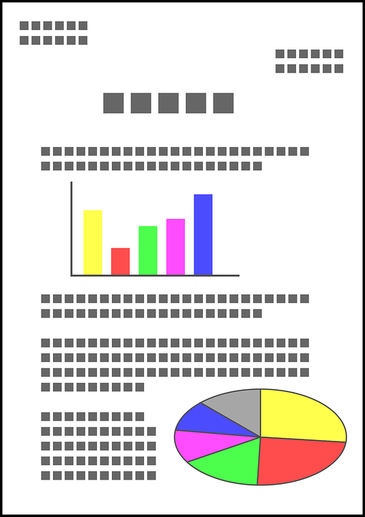
Reporting and Inventory Management
Generate reports on events periodically for audit evidence collection
Expose the events as read-only for everyone to view and analyze
Serve as inventory for triaging, building audit trails and ownership
Notes:
IMAGE SOURCE: https://pixabay.com/vectors/document-graph-report-approval-2034326/
Once, the events are in place, they can be run through a rule engine to detect anomalies and unexpected changes which are easy to detect because osquery can emit events only when it sees a diff. The event could be passed through a live classifier to send out near real time alerts. The enriched data set can also be used to build machine learning models for determine a risk score for a resource. It could be used to generate reports or look for long term patterns. And, since the data is annotated, it serves as an inventory that is up to date all the time.

Slide 30
Can this extend to Mac and Windows
Linux is not the only platform out there

Slide 31

What about Mac and Windows?
Linux audit equivalents for Windows and MacOS
Windows event logs
EndpointSecurity Framework
Notes:
IMAGE SOURCE: https://pixabay.com/vectors/apple-linux-mac-penguin-windows-158063/
The Audit framework is mostly abstracted from the platform it runs and is only limited by the availability of event collecting agents and sources. It could do the same things on MacOS and Windows given the event source. Since the largest chunk of hardware running in an organization are their servers which is mostly linux which has a very rich source of audit information, linux was chosen for the implementation.

Slide 32

What more could it do?
The Roadmap
Integrate distributed query mechanism
More flexible and expressive audit rules
Add tables to process the Linux audit logs
Publish config and queries for opensource log aggregators
Notes:
IMAGE SOURCE: https://pixabay.com/photos/road-highway-travel-asphalt-sky-3186188/
Given that osquery is flexible, we would eventually complete the featureset with
Distributed query mechanism for targeted information retrieval near real time
Make audit rules easier and more canonical to write and distribute
Abstract the audit logs parsing function completely from osquery to avoid building things that not everyone would like to use.
Publish instructions for how to set up opensource log aggregators and what queries to make in order to extract interesting data that you would care about.

Slide 33


How to apply the frameworks
Evaluate – What do you need?
How long does it take for you to track an event to a resource
What’s the scope of your compliance in terms of controls
What data points you need for your compliance
How complex is your infrastructure
Evaluate – What do have?
How visible are your servers
What components can you reuse for implementing the audit framework as they are first class citizens
What controls you already have and how many of them are redundant
Notes:
Figure out what you need for your resources. Ask yourself these questions.
How long does it take to track a resource from an event. What controls do you require for your compliance. What data points do you care about. How complex is your infra.
Figure out what components you already have within your organization which can help you bootstrap the audit framework.
How visible are your servers to you, Do you have an orchestrator, log collection pipeline, artifactory servers, a Certification authority, etc. How many agents do you have deployed that have overlapping functions and you don’t leverage all of it.

Slide 34
Resources
Implementations and more details can be found at
github.com/open-osquery/framework
github.com/open-osquery/trails-ext
github.com/open-osquery/libauditgo
github.com/open-osquery/trailsc
github.com/open-osquery/benchmark
Notes:
Repositories that hold an implementation and docs for the framework

